Slide 1




Team number : J022202
Team members:
Abdirahman Ahmed
Ziad Ayman
Mohamed Abdel Naser
merenda Bassem
Salma Khaled

Slide 2
Smart tour guide

Slide 3
Introduction
The problem is that tourists do not know some of the historical places as monuments and statues, and they always need a tour guide so that he can give them the information they want to know.
we will put all the information, pictures, and the information about the famous historical places in Egypt, and the tourist will be helped through this program. We put a voice, but we will put many features and modifications to this solution

Slide 4
Methods and Materials
Materials: Hardware :
1-pc
2- camera (image about status)
3- text
Give user some information about statues
Methods :
Picture and data about most famous tourist sites all over Egypt will be collected data and fed into app . To help tourist

Slide 5
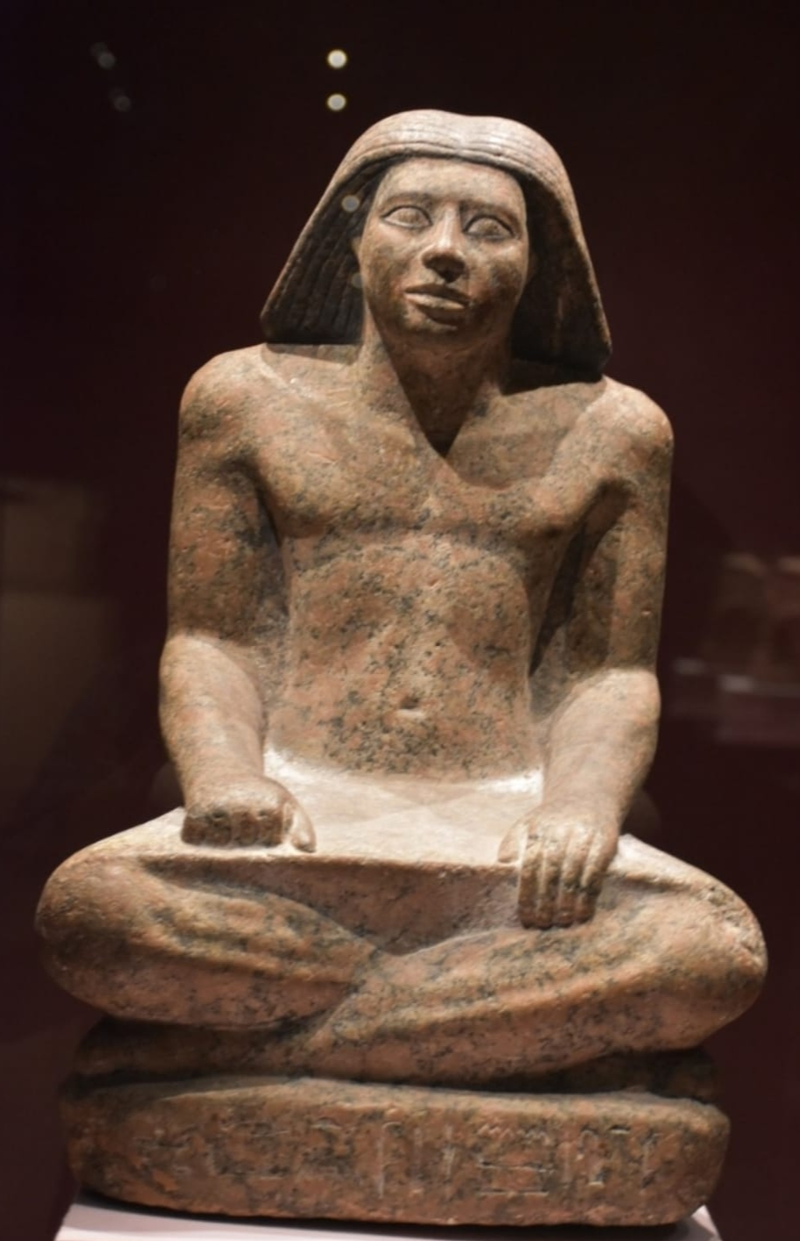
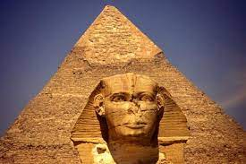
Results and data analysis
We collected the data. which is about 2 classes, and each class consists of 40 photos from the temples and monuments from all directions, and also a special label for each class, as well as the specifications of statues like age materials , symbol .

Slide 6
Conclusions
The problem is that tourists do not know the history of monuments and statues, and they always need a tour guide so that he can give them the information they want to know,
The solution is an application in which the user takes pictures of the statue from any side of it, and the application output will be some information about the real statue
We take photograph the statue, each statue 40 pictures from all its aspects, the app will supply us with the needed information

Slide 7
Recommendation
her, we have collected data from archaeological sites such as the sphinx and Amenhotep
We will collect information about the customs and traditions of the ancient Egyptians, religion, and wars

Slide 8
References
1) Amenhotep (
Ahmed, T. (2022). . Hurghada Excursions Lovers | Best Egypt Tours / Travel Agency. https://hurghadalovers.com/ar/king-amenhotep-iii-egyptian-pharaohs-kings/
2) sphinx . https://ar.wikipedia.org/wiki/%D8%A3%D8%A8%D9%88_%D8%A7%D9%84%D9%87%D9%88%D9%84

Slide 9
Acknowledgement
We are thankful this people
1) Ms. Rasha
2) Mr.. Abdelrahman
3) Mr. Mohamed adlay
3) Mr. Kareem

Slide 10
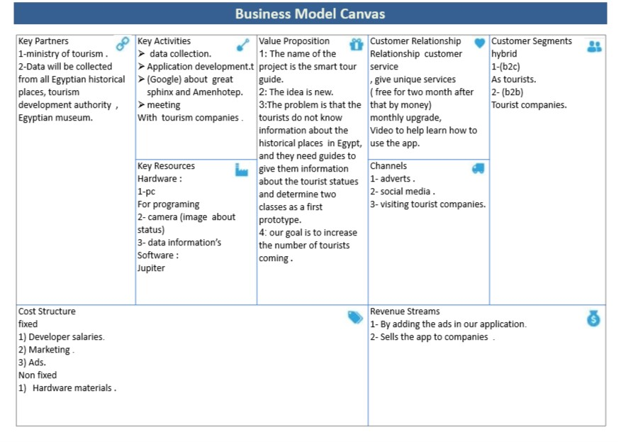

Slide 11
Thanks

